Slide 1
HealthHack
Krupal Patel
ENSE405
Activity#2

Slide 2

UN SD goal

Slide 3
Community Orientation
Individual Participation
Access to expertise
Verified content
Nutritionist

Slide 4
MVP
BMI Calculator
Meal opinions
Tip of the day (Meal, Exercise, Tip/fact)

Slide 5
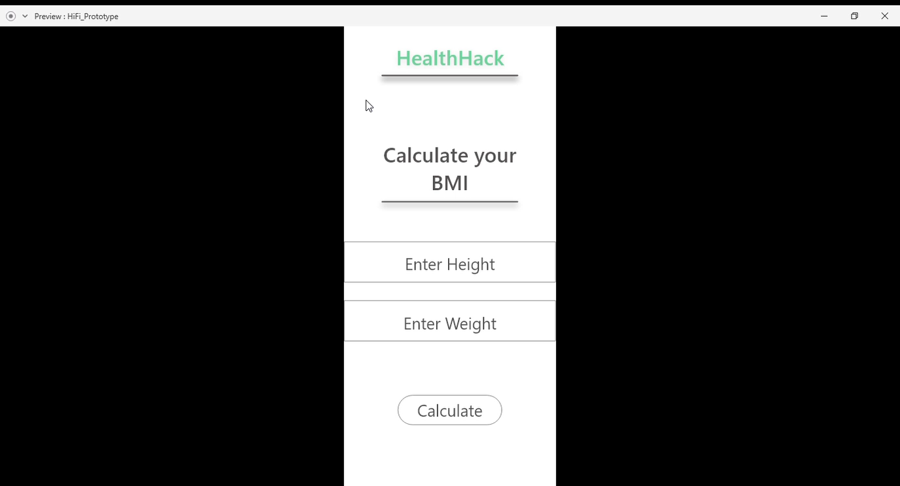

Slide 6
Any envisioned constraints
Web Scrapping
Content legitimization

Slide 7
Thanks

